Slide 1
WP5: Characterization of the Respiratory Microbiome Status Update: Microbiota
Stefan Boers
2016-07-04

Slide 2
Overview
Sample processing
Galaxy for MYcrobiota

Slide 3
Sample processing

Slide 4
Shipments
Partner | E-Swabs
UMCU | 517 patients
MeMed | 380 patients
Hadassah | 193 patients 25 control adults 25 control children
ALL | 1,140

Slide 5
DNA extraction
Partner | E-Swabs | DNA extracted
UMCU | 517 patients | 211/517 (41%)
MeMed | 380 patients | 380/380 (100%)
Hadassah | 193 patients 25 control adults 25 control children | 193/193 (100%) 25/25 (100%) 25/25 (100%)
ALL | 1,140 | 834/1,140 (73%)
DNA extraction protocol:
Phenol bead-beating combined with Agowa-Mag-mini DNA extraction kit
Deep Sequencing Analyses of Low Density Microbial Communities:
“Agowa retrieved the highest DNA levels”
“Agowa captured all taxa including the hard to lyse taxa”
PLoS ONE, 2012, 7: e32942

Slide 6
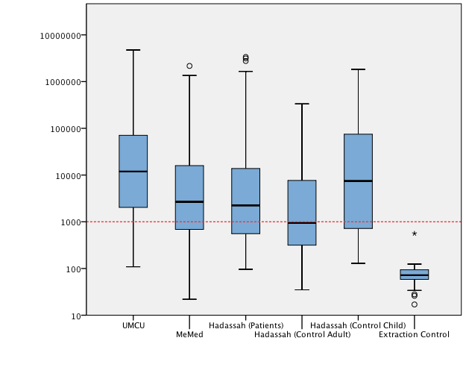
q16S PCR results
16S rRNA gene copies / μl
Boxplots represent the median (line), 25th and 75th percentile (box), minimum and maximum within 1.5*IQR (whiskers)
Threshold at 1,000 16S copies/μl for working with low density materials
J. Clin. Microbiol., 2002, 40(9): 3449

Slide 7
Why is there a threshold?
Environmental DNA or microbes can be introduced to samples at many points:
Sample collection,
DNA extraction, PCR reagents, Laboratory contamination
BMC Biol., 2014, 12: 87

Slide 8
Why is there a threshold?
Environmental DNA or microbes can be introduced to samples at many points:
Sample collection,
DNA extraction, PCR reagents, Laboratory contamination
Kits are not DNA-free!
BMC Biol., 2014, 12: 87

Slide 9
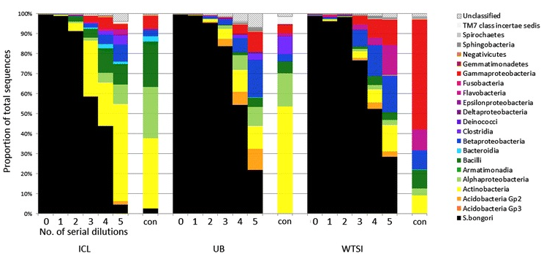
Why is there a threshold?
Environmental DNA or microbes can be introduced to samples at many points:
Sample collection,
DNA extraction, PCR reagents, Laboratory contamination
Serial dilution of a S. bongori pure culture:
Kits are not DNA-free!
BMC Biol., 2014, 12: 87

Slide 10
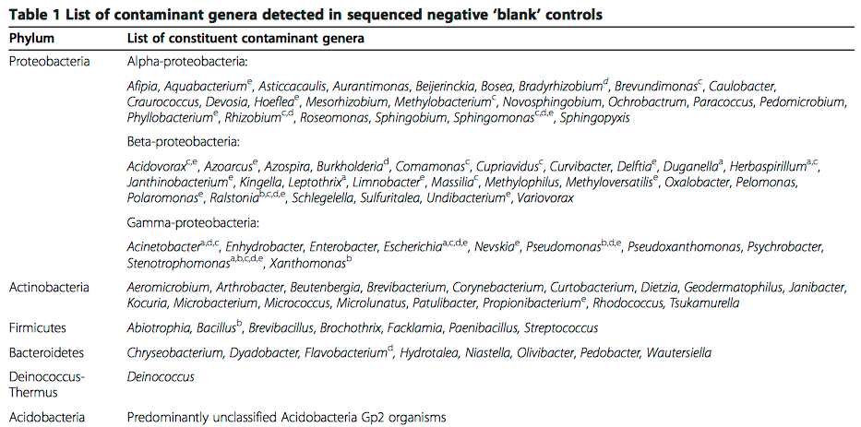
Why is there a threshold?
BMC Biol., 2014, 12: 87

Slide 11
DNA extraction
Partner | Total | Inhibited | [<100] | [>100 - < 1,000] | [>1,000]
UMCU | 211 | 1 (1%) | 0 (0%) | 34 (16%) | 176 (83%)
MeMed | 380 | 8 (2%) | 9 (2%) | 105 (28%) | 258 (68%)
Haddasah – Patients | 193 | 0 (0%) | 1 (1%) | 68 (35%) | 124 (64%)
Hadassah – Control A. | 25 | 0 (0%) | 1 (4%) | 12 (48%) | 12 (48%)
Hadassah – Control C. | 25 | 0 (0%) | 0 (0%) | 7 (28%) | 18 (72%)
ALL | 834 | 9 (1%) | 11 (1%) | 226 (27%) | 588 (71%)
Every sample is going to be sequenced
Last week’s run: 149 samples

Slide 12
Preliminary NGS results
http://www.phinch.org/viz.html

Slide 13
Galaxy for MYcrobiota

Slide 14
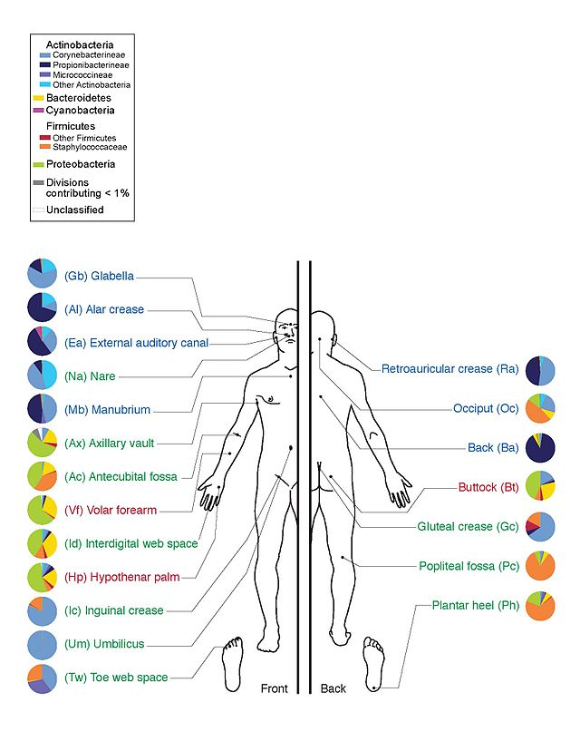
Data analysis
~ 25.000.000 reads

Slide 15
Workflow
Pre-processing
Artefact removal
Taxonomy assignment
OTU clustering
Results
Reporting

Slide 16
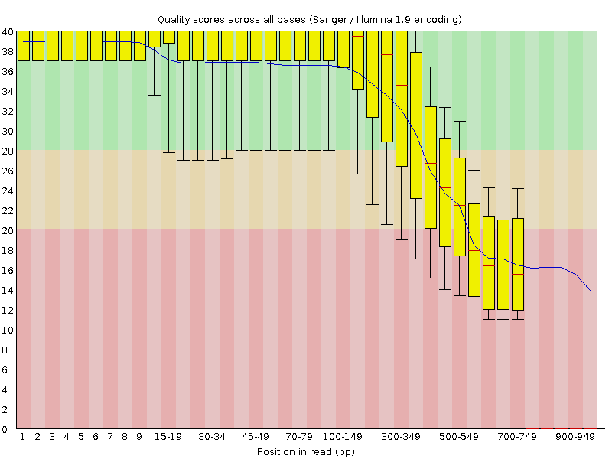
Pre-processing
Good
Okay
Bad
There are a lot of options to filter and trim your data…
However, this does not always improve things as we lose information!

Slide 17
Chimera formation
Genome Res, 2011, 21: 494-504

Slide 18
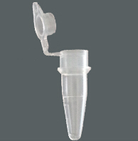
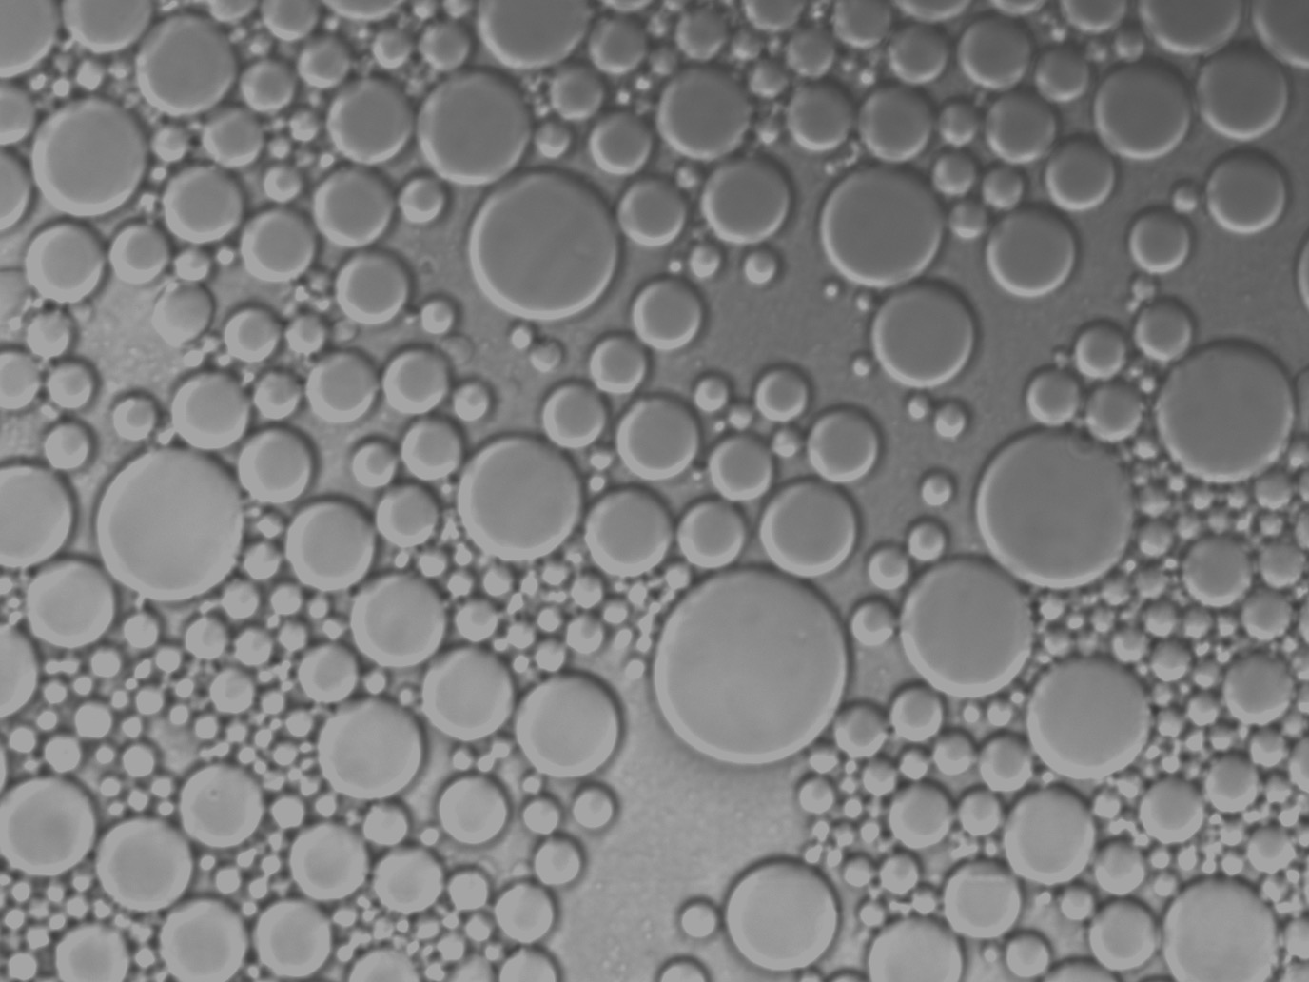

Prevent chimera formation
Standard PCR
1 compartment
Micelle PCR
10¹⁰ compartments
Sci Rep, 2015, 5: 14181

Slide 19
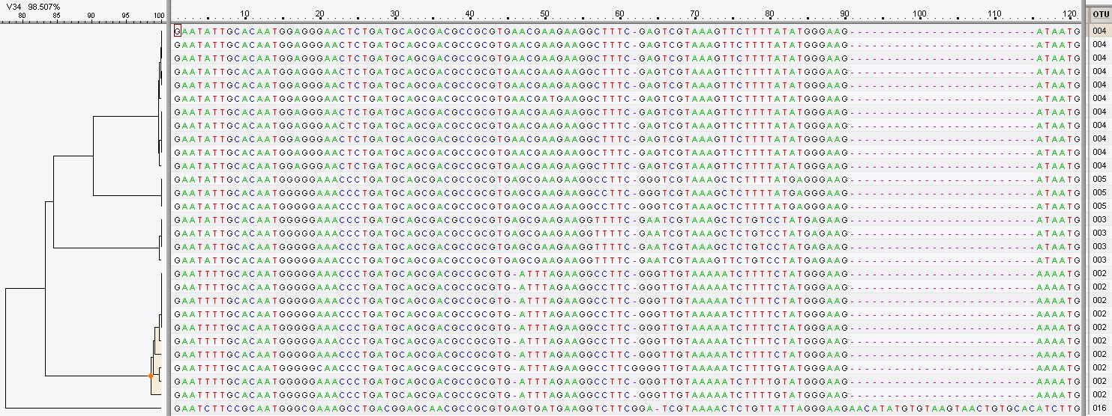
OTU Clustering
Clustering on basis of homology of the reads
97%

Slide 20
Assign taxonomy
Homology with reference databases (e.g. Silva, GreenGenes)
Accuracy depends on quality and completeness of databases used
Databases are inevitably incomplete
Manual evaluation recommended (e.g. NCBI blast)

Slide 21
Results

Slide 22
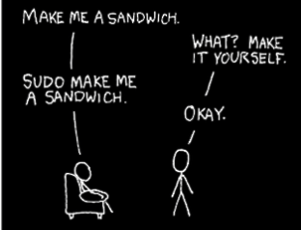
How to do all that?
Two pieces of very sophisticated open source software:
mothur
QIIME
Both programs are driven from the command line
Requires bioinformatics skills
Results depend on algorithms used and their settings
Development of MYcrobiota:
Translation of a validated workflow in a user-friendly (automated) pipeline in Galaxy
“Plug and Play” – standardized algorithms and settings
Quality control – where did I lose reads and the ability to download them to check!
Ability to optimise reference 16S databases for variable region sequenced
User defined reporting based on iReport functionality
Dynamic visualization of bacterial taxonomies and alpha/beta diversities (Krona/Phinch)

Slide 23
Galaxy
Open, web-based platform for data intensive biomedical research
User-friendly:
Graphical interface for command-line tools
User can build workflows graphically
Full analysis recorded in the history
Sharing of datasets and workflows amongst users
Free and open-source, large user/developer community
Toolshed: Galaxy App store (3000+ tools and counting…)

Slide 24
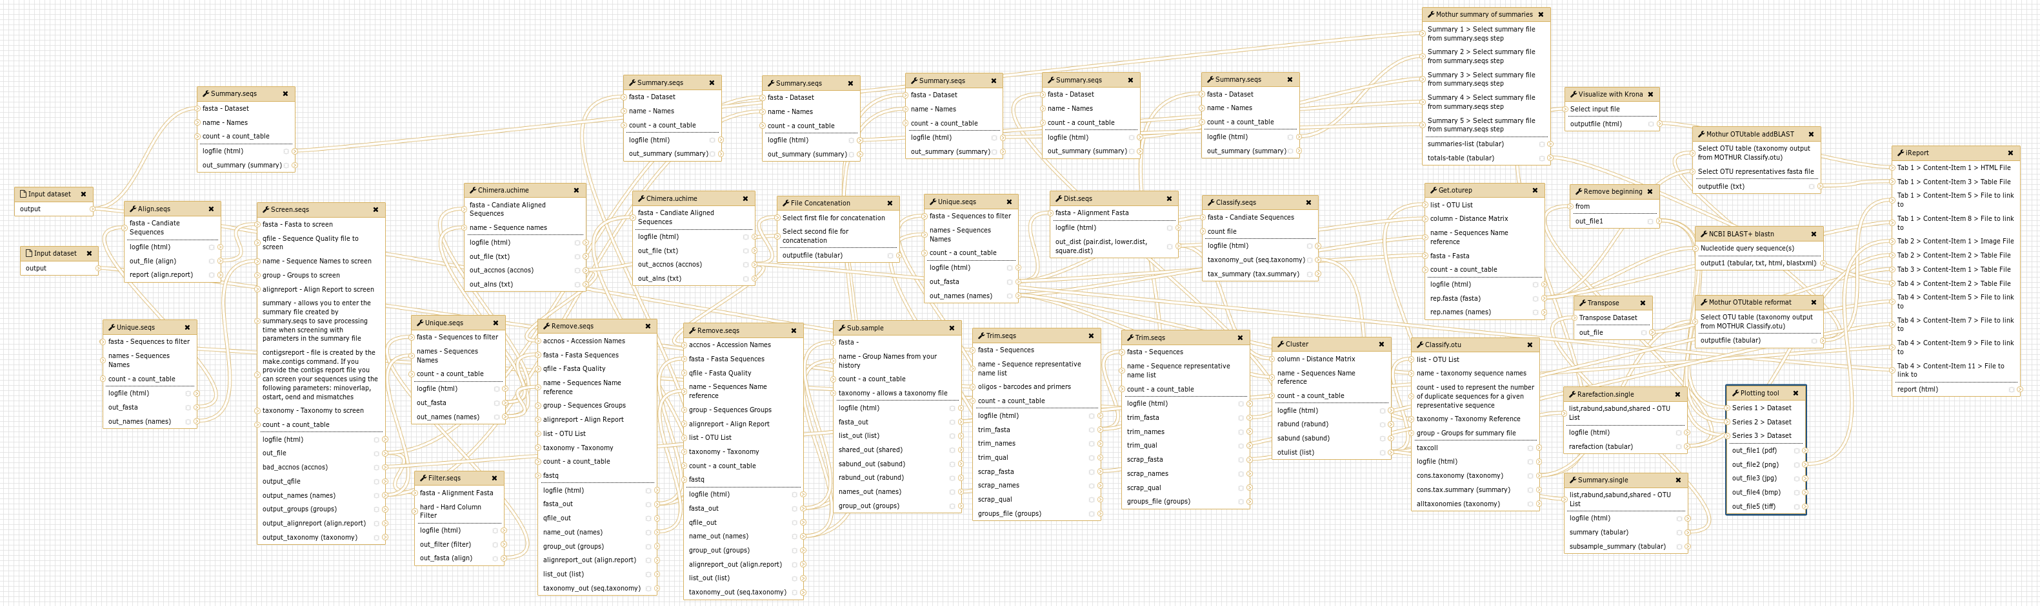
MYcrobiota

Slide 25
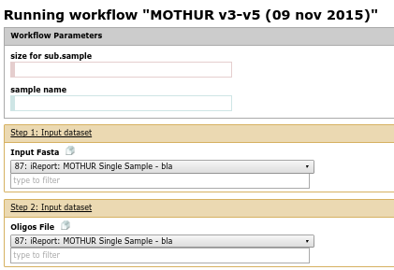
MYcrobiota
User just specifies input files and clicks Execute!

Slide 26
MYcrobiota
https://bioinf-galaxian.erasmusmc.nl/galaxy/

